Slide 1
K means Clustering

Slide 2
The K means Clustering algorithm is as follows.
Given k, the k-means algorithm consists of four steps:
Select initial centroids at random.
Assign each object to the cluster with the nearest centroid.
Compute each centroid as the mean of the objects assigned to it.
Repeat previous 2 steps until no change.

Slide 3
Example :
As a simple illustration of a k-means algorithm, consider the following data set consisting of the scores of two variables on each of seven individuals:

Slide 4
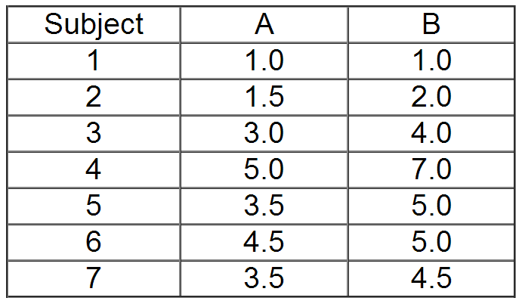

Slide 5
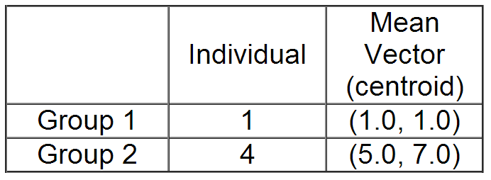
This data set is to be grouped into two clusters. As a first step in finding a sensible initial partition, let the A & B values of the two individuals furthest apart (using the Euclidean distance measure), define the initial cluster means, giving:

Slide 6
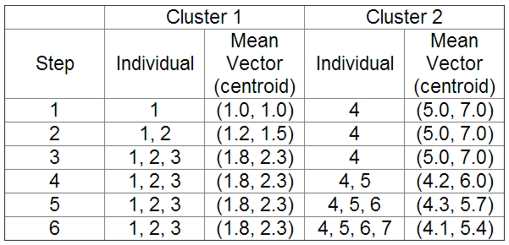
The remaining individuals are now examined in sequence and allocated to the cluster to which they are closest, in terms of Euclidean distance to the cluster mean. The mean vector is recalculated each time a new member is added. This leads to the following series of steps:

Slide 7
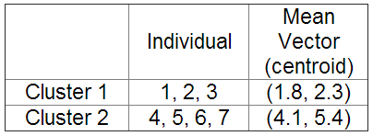
Now the initial partition has changed, and the two clusters at this stage having the following characteristics:

Slide 8
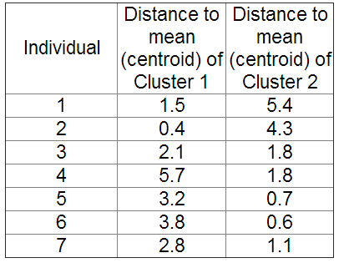
But we cannot yet be sure that each individual has been assigned to the right cluster. So, we compare each individual’s distance to its own cluster mean and to that of the opposite cluster. And we find:

Slide 9
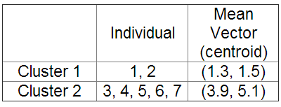
Only individual 3 is nearer to the mean of the opposite cluster (Cluster 2) than its own (Cluster 1). In other words, each individual's distance to its own cluster mean should be smaller that the distance to the other cluster's mean (which is not the case with individual 3). Thus, individual 3 is relocated to Cluster 2 resulting in the new partition:

Slide 10
The iterative relocation would now continue from this new partition until no more relocations occur. However, in this example each individual is now nearer its own cluster mean than that of the other cluster and the iteration stops, choosing the latest partitioning as the final cluster solution.

